Slide 1


Computer
Lecture 8
Dr. Nada Abdullah Rasheed
Assist prof. / Computer Science

Slide 2
Syllabus Content
Subject | Lec. No.
Primary Memory (Main Memory) | 3
Random Access Memory (RAM) | 4
Read Only Memory | 6
Secondary Memory | 7
Characteristics of Secondary Memory | 8
Memory Units | 9
Storage Devices | 10

Slide 3
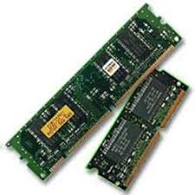
➢ Primary Memory (Main Memory)
Primary memory holds only those data and instructions on which the computer is currently working. It has a limited capacity and data is lost when power is switched off. It is generally made up of semiconductor device. These memories are not as fast as registers. The data and instruction required to be processed resides in the main memory. It is divided into two subcategories RAM and ROM.
Characteristics of Main Memory:
• It is known as the main memory.
• Usually volatile memory.
• Data is lost in case power is switched off.
• It is the working memory of the computer.
• Faster than secondary memories.
• A computer cannot run without the primary memory.

Slide 4
❖ Random Access Memory (RAM)
Known as primary storage, it is the main working memory of the computer system. Data and programs currently in use are held in RAM. It is called random access because data can be accessed in any order. RAM is the internal memory of the CPU for storing data, program, and program result. It is a read/write memory which stores data until the machine is working. As soon as the machine is switched off, data is erased. Access time in the RAM is independent of the address, that is, each storage location inside the memory is as easy to reach as other locations and takes the same amount of time.

Slide 5
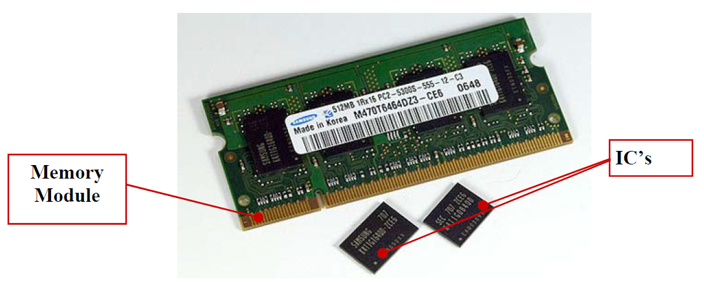
Data in the RAM can be accessed randomly, but it is very expensive. RAM is small, both in terms of its physical size and in the amount of data it can hold. RAM is of two types:- Static RAM (SRAM) Dynamic RAM (DRAM).

Slide 6
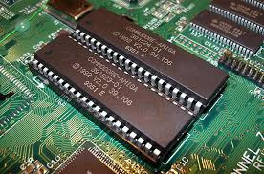
❖ Read Only Memory
ROM stands for Read Only Memory. The memory from which we can only read but cannot write on it. This type of memory is non-volatile. The information is stored permanently in such memories during manufacture. A ROM stores such instructions that are required to start a computer. This operation is referred to as a bootstrap. ROM chips are not only used in the computer, but also other electronic items like a washing machine and microwave oven.

Slide 7
Secondary Memory
This type of memory is also known as external memory or non-volatile. It is slower than the main memory. These are used for storing data/information permanently. CPU directly does not access these memories; instead they are accessed via input-output routines. The contents of secondary memories are first transferred to the main memory, and then the CPU can access it. For example, disk, CD-ROM, DVD, etc.

Slide 8
Characteristics of Secondary Memory
These are magnetic and optical memories.
It is known as the backup memory.
It is a non-volatile memory.
The data is permanently stored even if power is switched off.
It is used for storage of data in a computer.
The computer may run without the secondary memory.
Slower than primary memories.

Slide 9
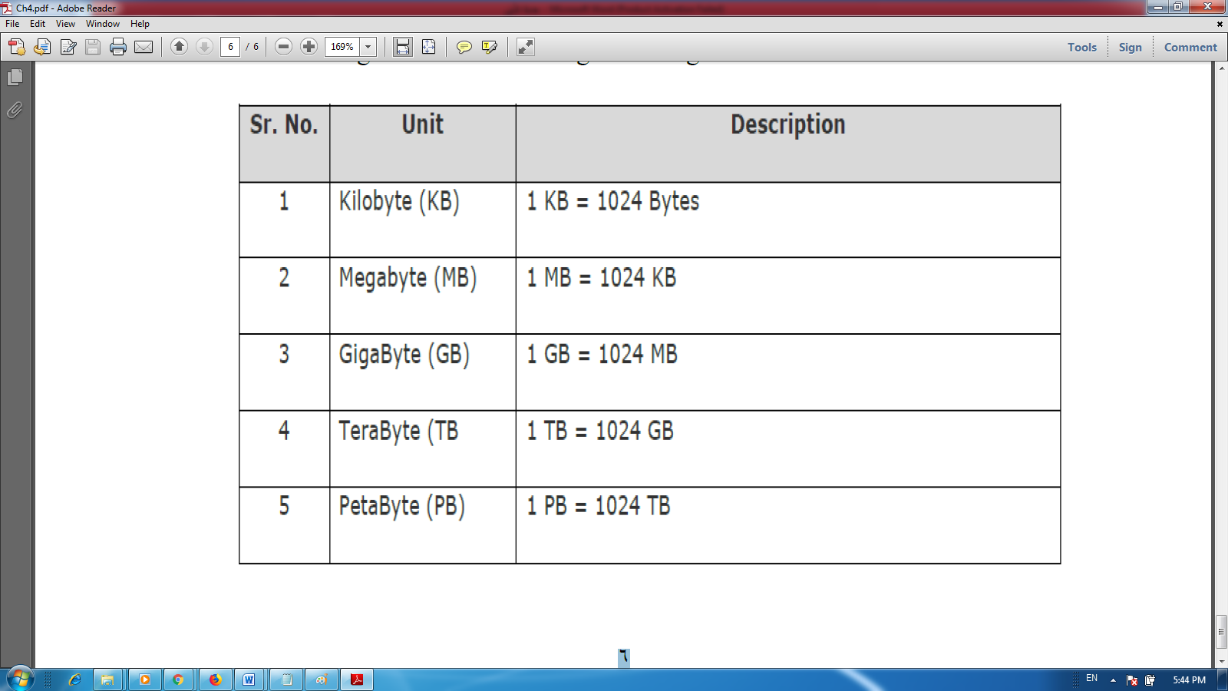
Memory Units: Memory unit is the amount of data that can be stored in the storage unit. This storage capacity is expressed in terms of Bytes. The following table lists some higher storage units:

Slide 10
Storage Devices
Refers to computer components, devices, and recording media that capable of storing data. Examples of storage devices:
– Floppy disk
– Hard disk
– Pen drive
– Optical disk

Slide 11
